Slide 1
Canadian Bioinformatics Workshops
www.bioinformatics.ca

Slide 2
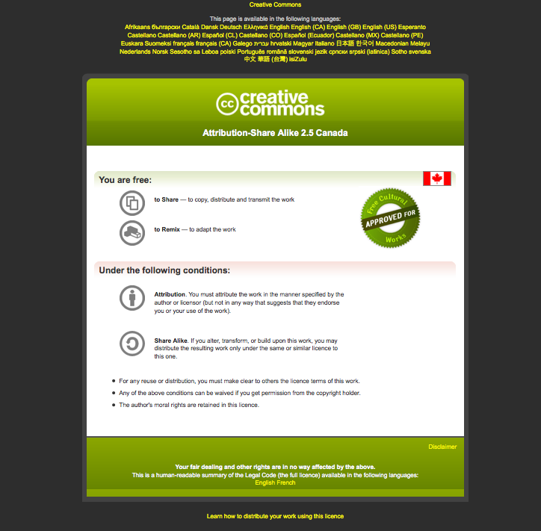
Module #: Title of Module
2

Slide 3
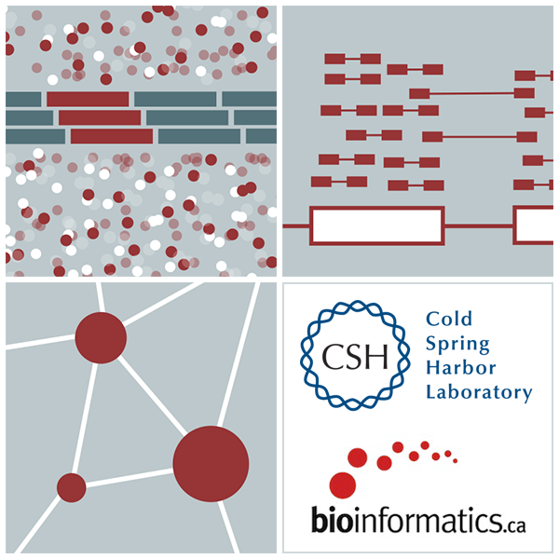


Module 15 More Depth on Pathway and Network Analysis
Robin Haw
High-Throughput Biology: From Sequence to Networks
March 20-26, 2017

Slide 4
Learning Objectives of Module
Understand the principles of pathway and network analysis.
Sources of pathway and network data.
Analytical approaches to data analysis, visualization and integration.
Overview of the construction and applications of the Reactome Functional Interaction (ReactomeFI) network.

Slide 5
What is Pathway/Network Analysis?
Any analytic technique that makes use of biological pathway or molecular network information to gain insights into a biological system.
A rapidly evolving field.
Many approaches.

Slide 6
Why Pathway/Network Analysis?
Dramatic data size reduction: 1000’s of genes => dozens of pathways.
Increase statistical power by reducing multiple hypotheses.
Find meaning in the “long tail” of rare cancer mutations.
Tell biological stories:
Identifying hidden patterns in gene lists.
Creating mechanistic models to explain experimental observations.
Predicting the function of unannotated genes.
Establishing the framework for quantitative modeling.
Assisting in the development of molecular signatures.
Notes:
The challenge lies very often in the analysis of a huge amount of data to extract meaningful information and use them to answer some of the fundamental biological questions.
Pathway analysis incorporates prior biological knowledge to analyze genes/proteins in groups in a biological context.
The method increases statistical power by integrating multiple perturbations for testing in a high-dimensional space.

Slide 7
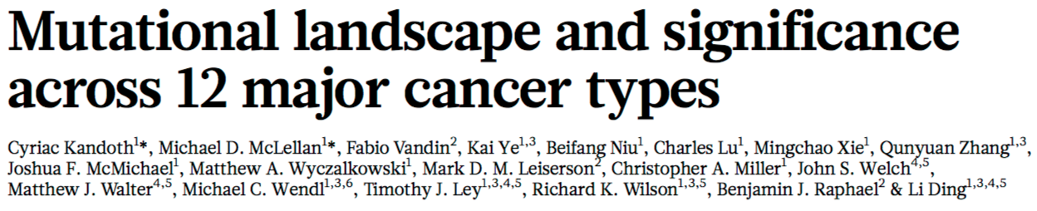
Why Pathway Analysis?
127 Cancer Driver Genes
ACVR1B, ACVR2A, AJUBA, AKT1, APC, AR, ARHGAP35, ARID1A, ARID5B, ASXL1, ATM, ATR, ATRX, AXIN2, B4GALT3, BAP1, BRAF, BRCA1, BRCA2, CBFB, CCND1, CDH1, CDK12, CDKN1A, CDKN1B, CDKN2A, CDKN2C, CEBPA, CHEK2, CRIPAK, CTCF, CTNNB1, DNMT3A, EGFR, EGR3, EIF4A2, ELF3, EP300, EPHA3, EPHB6, EPPK1, ERBB4, ERCC2, EZH2, FBXW7, FGFR2, FGFR3, FLT3, FOXA1, FOXA2, GATA3, H3F3C, HGF, HIST1H1C, HIST1H2BD, IDH1, IDH2, KDM5C, KDM6A, KEAP1, KIT, KRAS, LIFR, LRRK2, MALAT1, MAP2K4, MAP3K1, MAPK8IP1, MECOM, MIR142, MLL2, MLL3, MLL4, MTOR, NAV3, NCOR1, NF1, NFE2L2, NFE2L3, NOTCH1, NPM1, NRAS, NSD1, PBRM1, PCBP1, PDGFRA, PHF6, PIK3CA, PIK3CG, PIK3R1, POLQ, PPP2R1A, PRX, PTEN, PTPN11, RAD21, RB1, RPL22, RPL5, RUNX1, SETBP1, SETD2, SF3B1, SIN3A, SMAD2, SMAD4, SMC1A, SMC3, SOX17, SOX9, SPOP, STAG2, STK11, TAF1, TBL1XR1, TBX3, TET2, TGFBR2, TLR4, TP53, TSHZ2, TSHZ3, U2AF1, USP9X, VEZF1, VHL, WT1
Nature 502 (2013): 333-339
Notes:
The most cited reason for using a pathway database is to help analyze gene lists.
Just as an example, several groups from The Cancer Genome Atlas identified 127 genes, which they classified as cancer driver genes based on their mutation frequency.
We really don’t know what these 127 genes are doing, and why their mutations can caused cancer.
Pathway databases allow us to map these genes onto biological pathways and understand what their roles in these pathways.

Slide 8
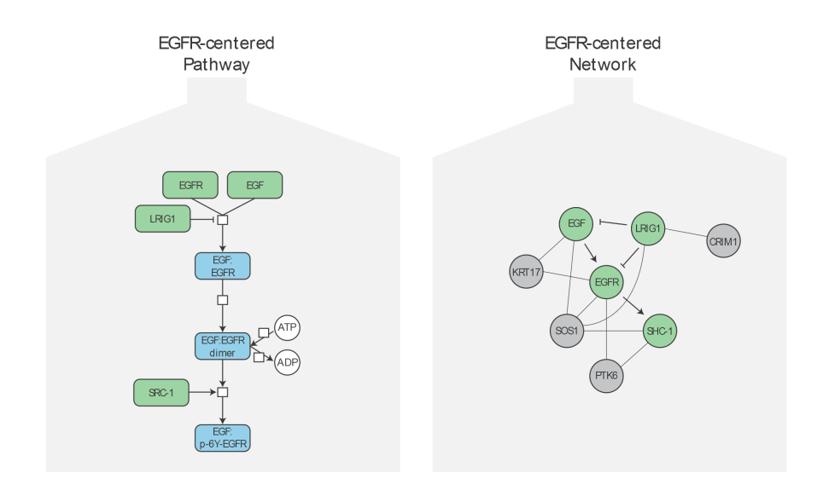
Pathways vs Networks
Notes:
A biological pathway is a series of actions among molecules in a cell that leads to a certain product or a change in the cell.
Metabolic pathways make possible the chemical reactions that occur in our bodies.
Signal transduction pathways move a signal from a cell's exterior to its interior.
Gene-regulation pathways turn genes on and off.
As for a network, they do not have a start or end point. In fact, many pathways have no real boundaries, and pathways often work together to accomplish tasks. When multiple biological pathways interact with each other, they form a biological network.
Researchers are able to learn a lot about human disease from studying biological pathways and networks. Identifying what genes, proteins and other molecules are involved in a biological pathway can provide clues about what goes wrong when a disease strikes.

Slide 9
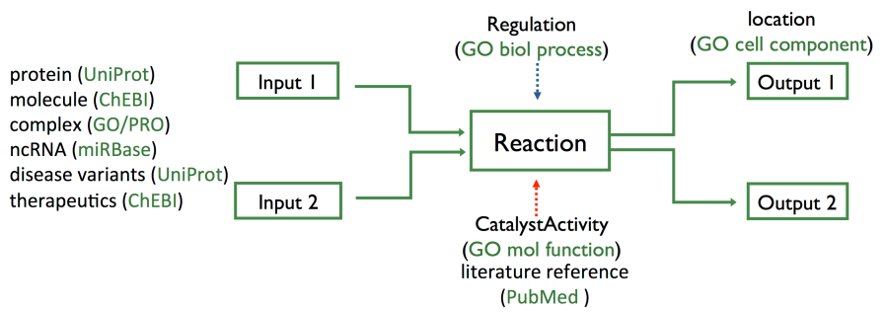
Reaction-Network Databases
Reactome & KEGG
explicitly describe biological processes as a series of biochemical reactions.
represents many events and states found in biology.
Notes:
The unit of reactome-network database is the reaction where each node represents a biomolecule and each edge represents the conversion of one or more biomolecule into another via a reaction.
We reference multiple entity databases to describe our biomolecules and Gene Ontology to explicitly describe key elements of the reaction.

Slide 10
KEGG
KEGG is a collection of biological information compiled from published material → curated database.
Includes information on genes, proteins, metabolic pathways, molecular interactions, and biochemical reactions associated with specific organisms
Provides a relationship (map) for how these components are organized in a cellular structure or reaction pathway.

Slide 11
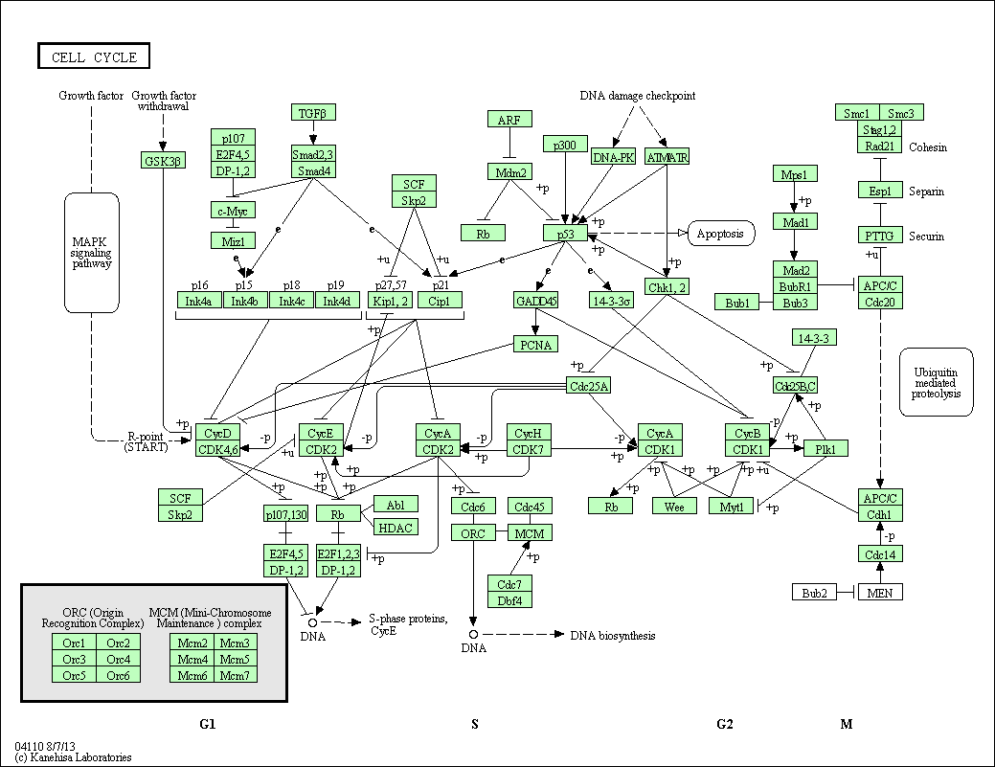
KEGG Pathway Diagram
Notes:
Green boxes = proteins
White boxes = genes
Encapsulated pathways
Simple lines to represent the reactions.

Slide 12

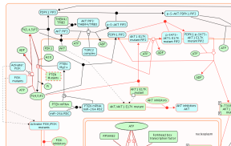
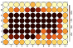
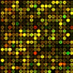
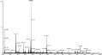
Reactome
Open source and open access pathway database
Curated human pathways encompassing metabolism, signaling, and other biological processes.
Every pathway is traceable to primary literature.
Cross-reference to many other bioinformatics databases.
Provides data analysis and visualization tools

Slide 13
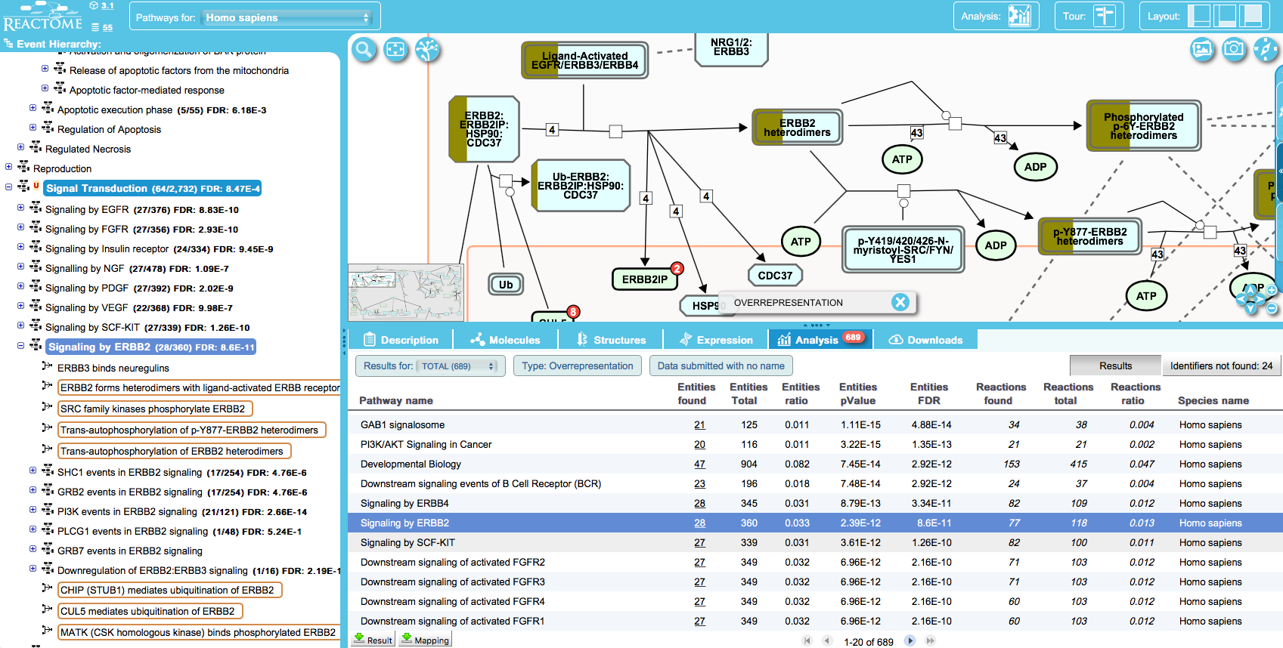
Pathway Browser: Pathway Enrichment Analysis
127 Cancer Driver Genes
Notes:
The pathway browser is the main visualization tool to browse biological pathways and to analyze experimental data, whether that is gene, protein or small molecule lists.
The pathway hierarchy is in the left panel, the diagram view in the right, and a details panel provides information as the user interacts with the pathway diagram.
In this particular screenshot, we are looking at expression data overlaid onto a pathway diagram.
Let’s look at our 127 cancer driver genes. Here is some of enrichment analysis results. One pathway, Signaling by ERBB2, was selected in this slide.

Slide 14
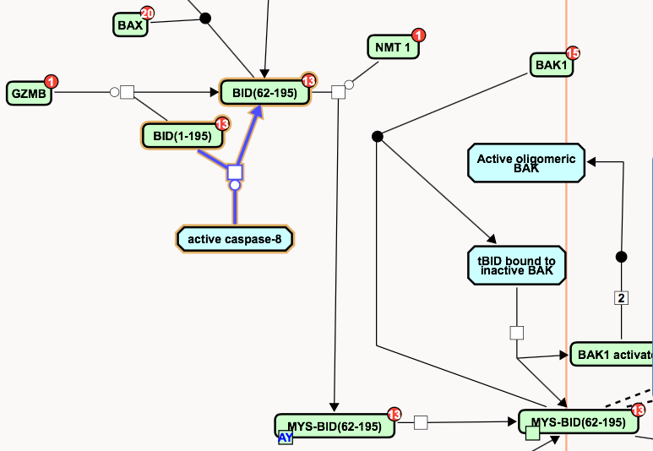
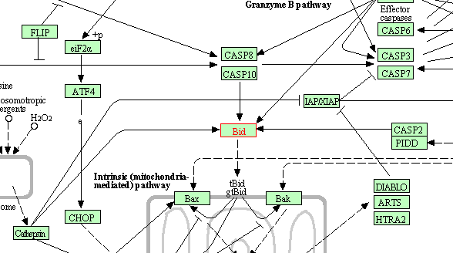
Reactome vs KEGG
http://www.genome.jp/kegg-bin/show_pathway?hsa04210
Notes:
If you compare our annotation with another very popular pathway database, KEGG, you can see the difference: KEGG just annotated this reaction as a simple activation: CASP8 or CASP10 activates Bid without providing the actual mechanism occurring inside cells.
Reactome provides the detailed mechanism, which provides information for more advanced pathway analysis based on sophisticated math models and for drug development.

Slide 15
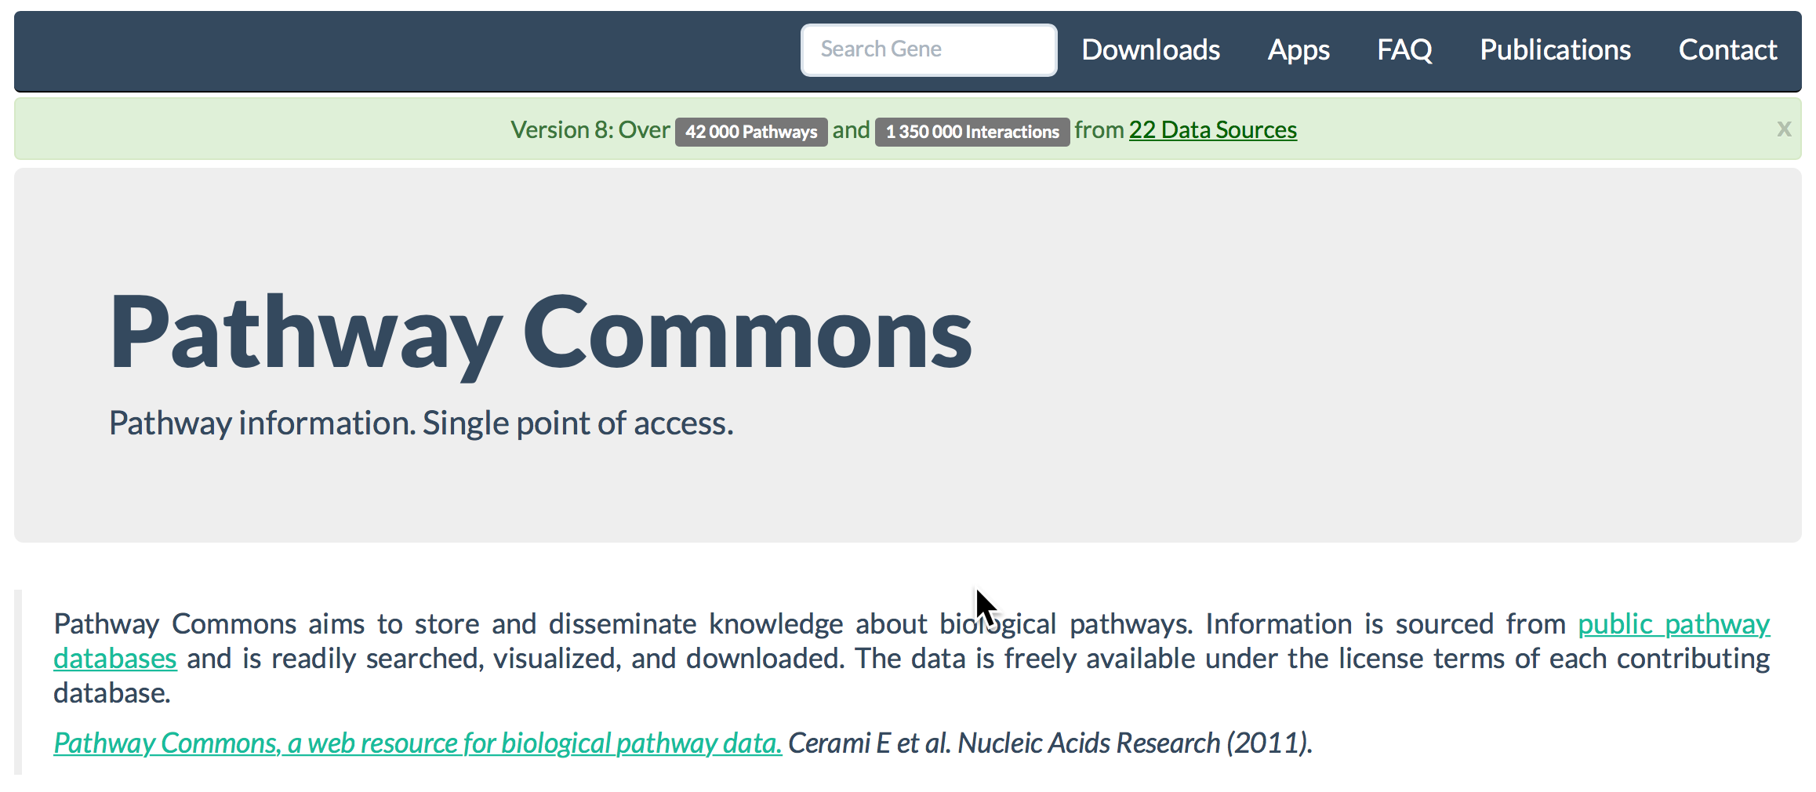
Pathway and Network Compendia
Notes:
Pathway Commons is a very useful network biology resource and acts as a convenient point of access to biological pathway information collected from public pathway databases.
You can search, visualize and download pathway and network information.

Slide 16
What is a Interaction Network?
An Interaction Network is a collection of:
Nodes (or vertices).
Edges connecting nodes (directed or undirected, weighted, multiple edges, self-edges).
node
edge
Nodes can represent proteins, genes, metabolites, or groups of these (e.g. complexes) - any sort of object.
Edges can be either physical or functional interactions, activators, regulators, reactions - any sort of relations.

Slide 17
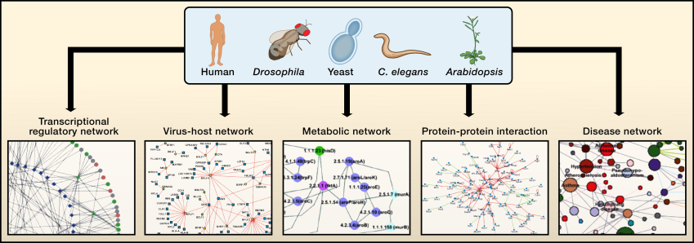
Types of Interactions Networks
Vidal, Cusick and Barbasi, Cell 144, 2011.
Notes:
Cellular networks are most available for the ‘‘super-model’’ organisms:
In a transcriptional regulatory network, nodes represent transcription factors (circular nodes) or putative DNA regulatory elements (diamond nodes); and edges represent physical binding between the two.
In a virus-host network, square nodes represent viral proteins or round nodes represent host proteins, and edges represent physical interactions between the two.
In a metabolic network, nodes represent enzymes, and edges represent metabolites that are products or substrates of the enzymes.
In a disease network, nodes represent diseases, and edges represent gene mutations of which are associated with the linked diseases.
The most common and we will talk more about this today is the protein-protein interaction network, nodes represent proteins and edges represent physical interactions.

Slide 18
Network Databases
Can be built automatically or via curation.
More extensive coverage of biological systems.
Relationships and underlying evidence more tentative.
Popular sources of curated human networks:
BioGRID – Curated physical and genetic interactions from literature; 65K interactors & 1.1M interactions.
IntAct – Curated interactions from literature; 95K interactors & 694K interactions.
Notes:
Large scale identification of PPIs generated hundreds of thousands interactions, which were collected together in specialized biological databases that are continuously updated in order to provide complete interactomes.
Differ based upon species coverage, types of interactions they describe, level of detail in the interactions.

Slide 19
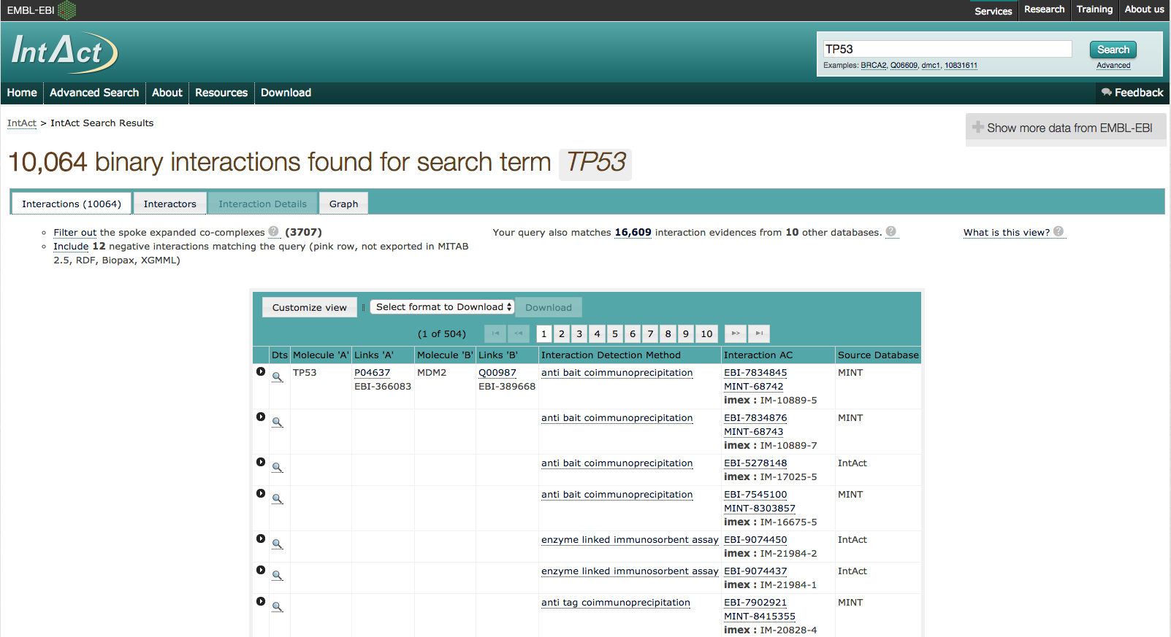
IntAct
Notes:
Just showing a screenshot of the search for TP53 in IntAct.
Typical table of results describing the interactions.

Slide 20





Open Data Exchange
Standard graphical languages for representing biological processes and interactions
BioPAX
SBML level 2.3.
Open access interchange format for computer models of biochemical pathways, reactions and networks.
BioPAX level 2 & 3.
Standard language that aims to enable integration, exchange, visualization and analysis of biological pathway data.
PSICQUIC is an effort to standardize the access to molecular interaction databases.
PSI-MITAB is the data exchange format.
Notes:
To complement the tools I just talked about there are a wide variety of graph data representations available. The most popular are:
PSI MITAB – representing interaction data* (*infer interactions from the complexes and reactions).
SBML – representing models of biochemical pathways, reactions and networks.
BioPAX – used for representing pathway and network data.
SBGN – representing a graphical view of biological pathways and networks.

Slide 21
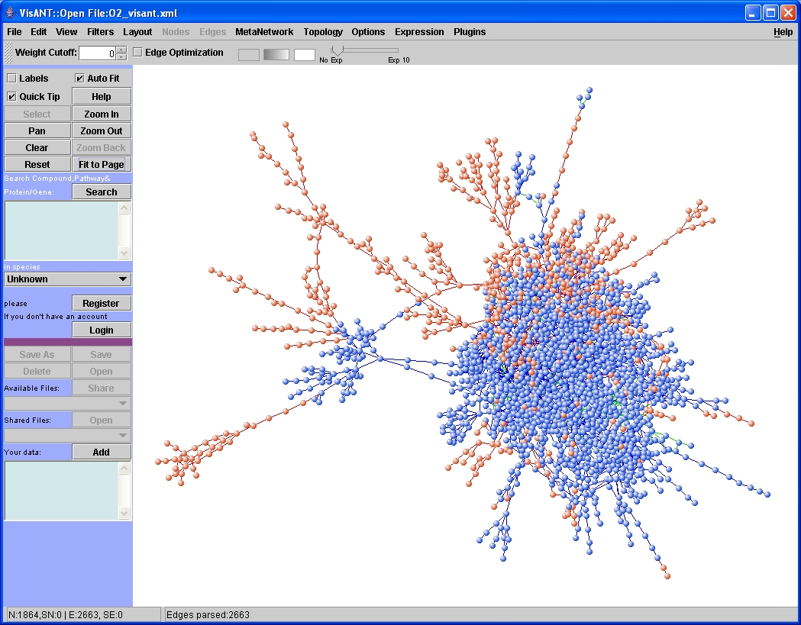
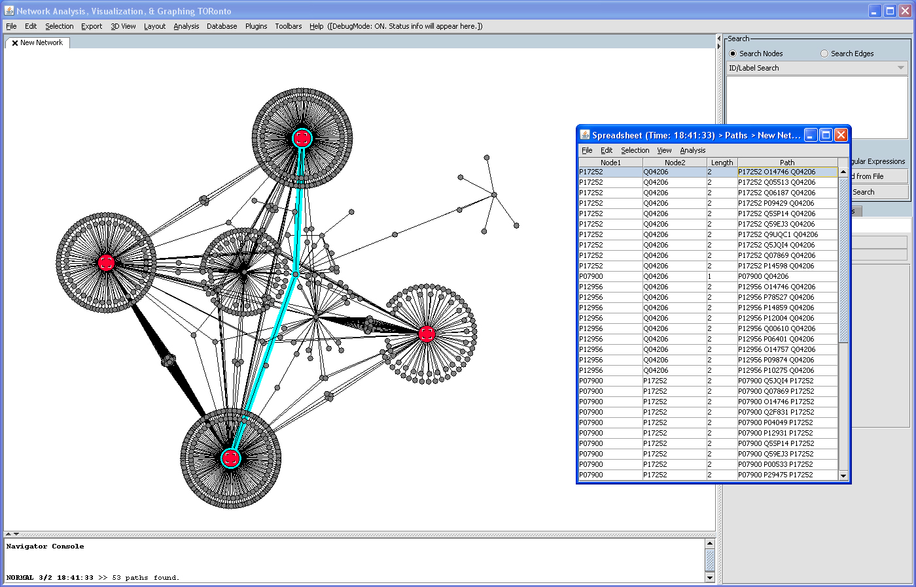
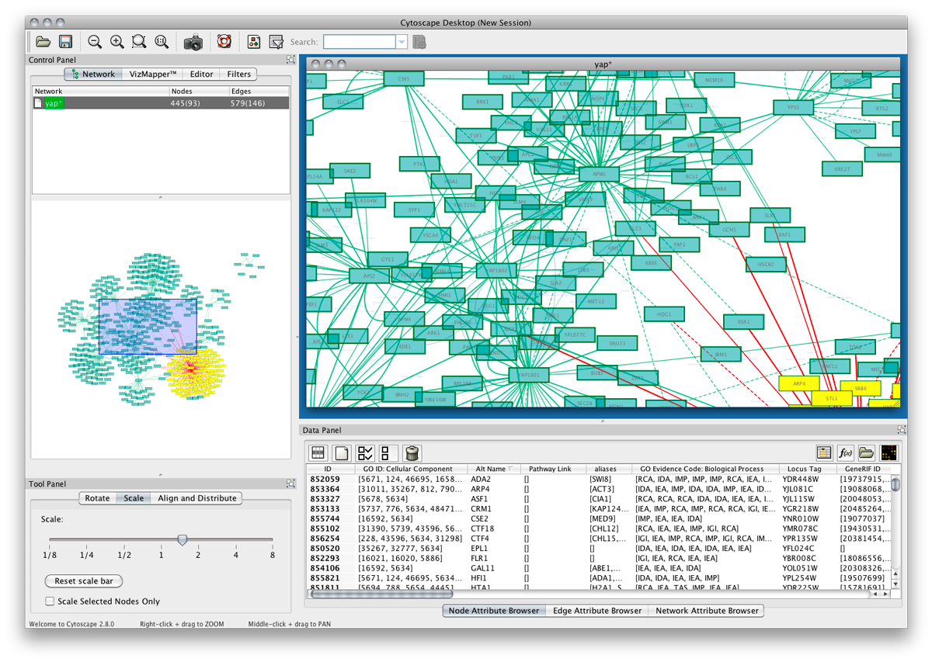
Visualization and Analysis Tools for Biological Networks
VisANT
NAVIGaTOR
Cytoscape
Notes:
Before, I introduce you to the different approaches to data analysis, I should introduce you to some of the tools:
Visant is a tool for visualization and manipulation of metabolic interaction networks. It builds data-rich graphical representations that are color-coded for gene function and experimental interaction data.
Navigotor is a powerful graphing application for the 2D and 3D visualization of biological networks. It includes a rich suite of visual mark-up tools, fast and scalable layout algorithms and is useful in the visualization of large graphs.
Cytoscape is an open source software platform for visualizing complex networks and integrating these with any type of attribute data. This is by far the most popular in bioinformatics.

Slide 22
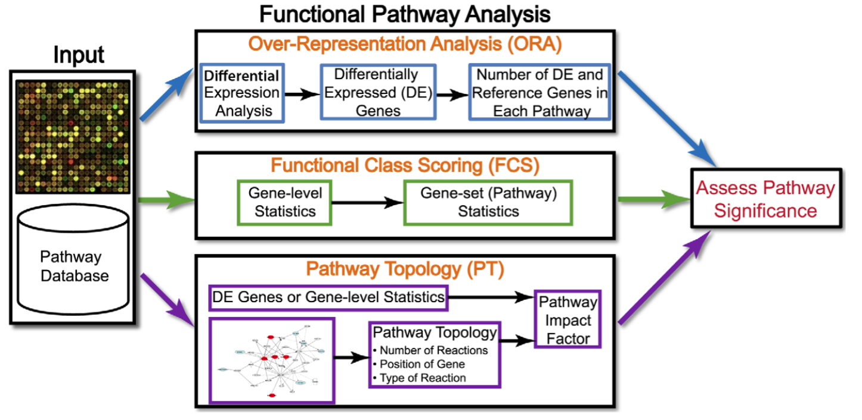
Pathway/Network Analysis Workflow
Khatri P et al. PLoS Comput Biol. 2012; 8(2): e1002375
Notes:
Several years ago, Khatri et al generated all pathway-based data analysis approaches into three generations in a review paper published in PLoS Computational Biology:
a pathway database is the foundation for performing pathway-based data analysis.
first generation over-repreasentation analysis for enrichment analysis
second generation functional class scoring (FCS) using gene-level statistic. The most popular approach in the second generation is called GSEA developed by the broad institute. The third generation takes use of pathway topological structures, including
third generation approaches called SPIA developed by a group in Wayne State University here in Detroit.
Now subsitute pathway for network. Sometimes the same algorithms, other times different approaches and also different data sets.

Slide 23
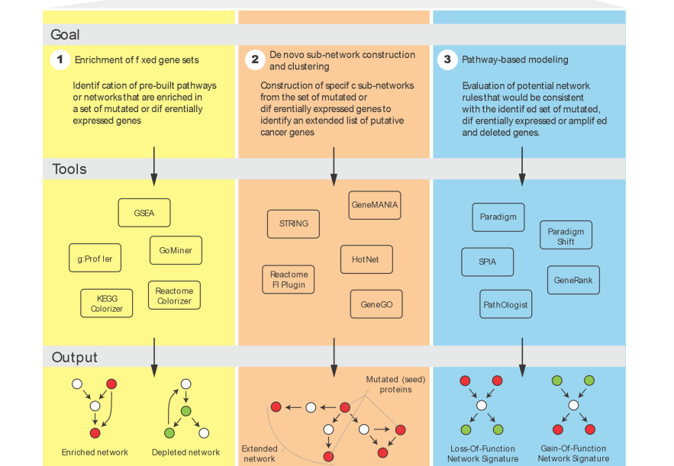
Types of Pathway/Network Analysis
Are new pathways altered in this cancer? Are there clinically-relevant tumour subtypes?
How are pathway activities altered in a particular patient? Are there targetable pathways in this patient?
What biological processes are altered in this cancer?
Notes:
Juri who talked to you yesterday, wrote a paper describing these approaches with consideration to different use cases.

Slide 24
Issues in Pathway-based Analysis
How to handle the pathway hierarchical organization?
Flatten pathways organized in a hierarchy into a systems-wide network
How to handle pathway cross-talks?
Shared genes/proteins will be listed once in a network
Interactions causing cross-talks are displayed in the same network
Notes:
By employing network-based approaches, we can address these two issues in pathway-based analysis.
By listing proteins or genes only onces in the network, we can view shared genes/proteins for cross-talked pathways.
By listing all interactions in the same network, we can investigate regulations between pathways.

Slide 25
More Challenged Issues in Pathway Data Analysis
Many omics data types available for one single patient
CNV, gene expression, methylation, somatic mutations, etc.
Pathway and network-based Simulation
How to use topological structures?
Predict drug effects: one drug or multiple drugs together?
Notes:
Here are another couple of challenges
One is how to integrate many omics data types together for pathway and network
Another is on pathway-based data simulation to take use of top..

Slide 26
Network-based Data Analysis
Based on systems-wide biological networks
Covering the majority of human genes
Usually protein-protein interaction networks
Modules (or clusters)-based network patterns
Pathway annotations via enrichment analysis
Gene signature or biomarker discovery
Disease genes discovery
Cancer drivers
Disease modules
Notes:
Network-based analysis approaches are built-upon systems-wide biological networks, which cover…
Many of network-based approaches help users to find network modules or clusters.
After that, users can annotate modules to find related pathways and search for network-based gene signatures or biomarkers.

Slide 27
2) De Novo Subnetwork Construction & Clustering
Apply list of altered {genes,proteins,RNAs} to a biological network.
Identify “topologically unlikely” configurations.
E.g. a subset of the altered genes are closer to each other on the network than you would expect by chance.
Extract clusters of these unlikely configurations.
Annotate the clusters.
Notes:
Alternatively, you can apply a list of altered {genes,proteins,RNAs} to a much larger pre-constructed biological network.
Identify “topologically unlikely” configurations by filtering away unnecessary interactions.
Extract clusters of these unlikely configurations.
Annotate the clusters.

Slide 28
Network clustering
Clustering can be defined as the process of grouping objects into sets called clusters (communities or modules), so that each cluster consists of elements that are similar in some ways.
Network clustering algorithm is looking for sets of nodes [proteins] that are joined together in tightly knit groups.
Cluster detection in large networks is very useful as highly connected proteins are often sharing similar functionality.
Notes:
Lets take a moment to talk about network clustering.

Slide 29
Popular Network Clustering Algorithms
Girvin-Newman
a hierarchical method used to detect communities by progressively removing edges from the original network
Markov Cluster Algorithm
a fast and scalable unsupervised cluster algorithm for graphs based on simulation of (stochastic) flow in graphs
HotNet
Finds “hot” clusters based on propagation of heat across metallic lattice.
Avoids ascertainment bias on unusually well-annotated genes.
HyperModules Cytoscape App
Find network clusters that correlate with clinical characteristics.
Reactome FI Network & ReactomeFIViz app
Offers multiple clustering and correlation algorithms (including HotNet, PARADIGM and survival correlation analysis)
Notes:
There are many different approaches to network clustering, and I am barely scratching the surface:
Girvin-Newman - Remove the edges of highest betweenness first. Continue this until the graph breaks down into individual nodes. As the graph breaks down into pieces, the tightly knit community structure is exposed with sparse connections between these modules.
Markov Cluster Algorithm - So in my limited understanding, the MCL algorithm simulates flow within a graph and promotes flow in a highly connected region and demotes otherwise, thus revealing natural groups within the graph. For example, A random walk in G that visits a dense cluster will likely not leave the cluster until many of its vertices have been visited.
HotNet – treats the gene network as a metallic lattice, and then uses physics of heat diffusion to model the effects of gene alterations. Each gene heats up its local region of the network, and the effect is figuratively propagated along metallic wires defined by gene-gene linkages, leading to hot (highly relevant) network neighbourhoods.
HyperModules – identifies subnetworks with cancer mutations that are maximally correleted with clincial characteristics (patient survival, tumour stage). This tools can be used to study tumour subtypes by extracting networks whose mutations are significanly enriched in a particular subtype.
I’ll talk about the Reactome FI Network Cytoscape (or ReactomeFIViz) in a moment.

Slide 30
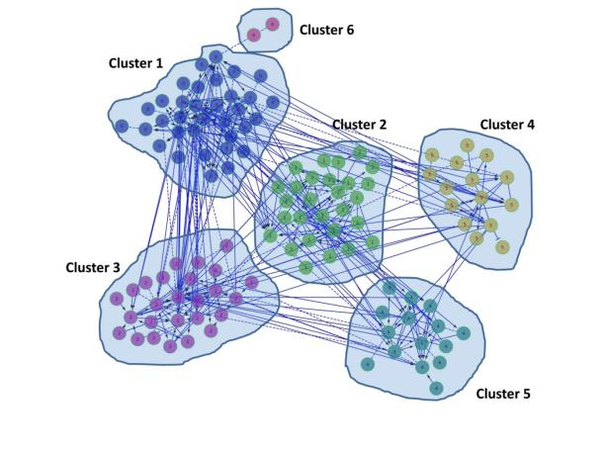
Typical output of a network
clustering algorithm
This hypothetical subnetwork was decomposed onto 6 clusters.
Different clusters are marked with different colors. Cluster 6 contains only 2 elements and could be ignored in the further investigations.
Clusters are mutually exclusive meaning that nodes are not shared between the clusters.
Notes:
The typical output of clustering is demonstrated in this hypothetical subnetwork.

Slide 31
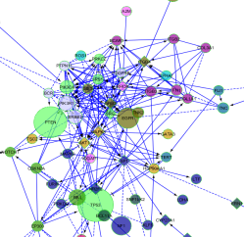
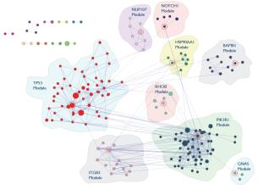
Reactome Functional Interaction (FI) Network and ReactomeFIViz app
No single mutated gene is necessary and sufficient to cause cancer.
Typically one or two common mutations (e.g. TP53) plus rare mutations.
Analyzing mutated genes in a network context:
reveals relationships among these genes.
can elucidate mechanism of action of drivers.
facilitates hypothesis generation on roles of these genes in disease phenotype.
Network analysis reduces hundreds of mutated genes to < dozen mutated pathways.
Notes:
Now I would like to introduce you to the Reactome Network and FI Viz app.
In particular, you are going to learn about how this tool can be used to analyze large gene-disease datasets.

Slide 32
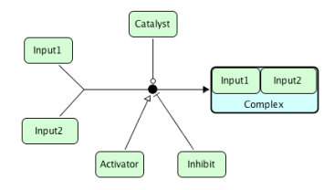
What is a Functional Interaction?
Convert reactions in pathways into pair-wise relationships
Functional Interaction: an interaction in which two proteins are involved in the same reaction as input, catalyst, activator and/or inhibitor, or as components in a complex
Reaction Functional Interactions
Input1-Input2, Input1-Catalyst,
Input1-Activator, Input1-
Inhibitor, Input2-Catalyst, Input2-
Activator, Input2-Inhibtior,
Catalyst-Activator, Catalyst-
Inhibitor, Activator-Inhibitor
Method and practical application: A human functional protein interaction network and its application to cancer data analysis, Wu et al. 2010 Genome Biology.
Notes:
A Functional interaction network is a reliable biological network based on manually curated pathways extended with verified interactions.

Slide 33
Construction of the FI Network
Human PPI
Mouse PPI
Reactome
Fly PPI
KEGG
Worm PPI
Panther Pathways
Yeast PPI
NCI-Nature
Lee’s Gene Expression
NCI-BioCarta
Prieto’s Gene Expression
Encode TF/Target
Domain Interaction
TRED TF/Target
GO BP Sharing
Data sources for annotated FIs
Data sources for predicted FIs
Featured by
Trained by
Validated by
Naïve Bayes Classifier
Predicted by
Extracted from
Predicted FIs
Annotated FIs
328K interactions
12K proteins
FI Network
Notes:
Two types of FIs:
one is extracted from human curated pathways and two TF/target interactions.
another predicted based on Naïve Bayes Classifier.
We use features extracted from human PPI, and PPI projected from several model organisms, gene co-expression data, protein domain interactions, and genes sharing GO BP annotations.
We re-build our FI network every year.
The current version of our FI network was built in December 2015 covers a little bit more than 12,000 human genes and about 328,000 Fis, with gene coverage of about 60%.

Slide 34
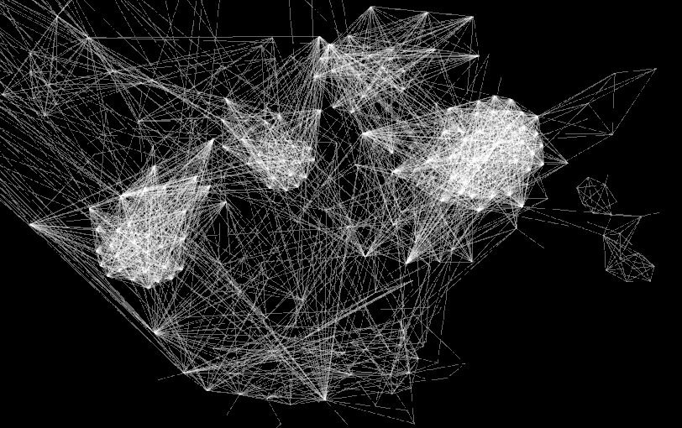
Projecting Experimental Data onto FI Network

Slide 35
127 Cancer Driver Genes
Signaling by EGFR, FGFR, SCF-KIT, etc.
ACVR1B, ACVR2A, AJUBA, AKT1, APC, AR, ARHGAP35, ARID1A, ARID5B, ASXL1, ATM, ATR, ATRX, AXIN2, B4GALT3, BAP1, BRAF, BRCA1, BRCA2, CBFB, CCND1, CDH1, CDK12, CDKN1A, CDKN1B, CDKN2A, CDKN2C, CEBPA, CHEK2, CRIPAK, CTCF, CTNNB1, DNMT3A, EGFR, EGR3, EIF4A2, ELF3, EP300, EPHA3, EPHB6, EPPK1, ERBB4, ERCC2, EZH2, FBXW7, FGFR2, FGFR3, FLT3, FOXA1, FOXA2, GATA3, H3F3C, HGF, HIST1H1C, HIST1H2BD, IDH1, IDH2, KDM5C, KDM6A, KEAP1, KIT, KRAS, LIFR, LRRK2, MALAT1, MAP2K4, MAP3K1, MAPK8IP1, MECOM, MIR142, MLL2, MLL3, MLL4, MTOR, NAV3, NCOR1, NF1, NFE2L2, NFE2L3, NOTCH1, NPM1, NRAS, NSD1, PBRM1, PCBP1, PDGFRA, PHF6, PIK3CA, PIK3CG, PIK3R1, POLQ, PPP2R1A, PRX, PTEN, PTPN11, RAD21, RB1, RPL22, RPL5, RUNX1, SETBP1, SETD2, SF3B1, SIN3A, SMAD2, SMAD4, SMC1A, SMC3, SOX17, SOX9, SPOP, STAG2, STK11, TAF1, TBL1XR1, TBX3, TET2, TGFBR2, TLR4, TP53, TSHZ2, TSHZ3, U2AF1, USP9X, VEZF1, VHL, WT1
Signaling by Notch, Wnt, TGF-beta, SMAD2/3, etc.
Cell Cycle
TP53 Pathway
Notes:
For example going back to the 127 cancer driver genes from the start of my talk.
We did a Reactome FI network based analysis by constructing a FI subnetwork, perform network clustering analysis, and annotate network modules.
Essentially, reduces 127 mutated genes to a handful of mutated pathways.

Slide 36
Module-Based Prognostic Biomarker in ER+ Breast Cancer
Low expression
High expression
Measure levels of expression of the genes in this network module
Guanming Wu
Notes:
By combining the ReactomeFI network with gene expression data it is possible to search for network modules that are related to patient overall survival.
First calculate gene expression correlations for genes involved in the Fis, and you assign corellations to FIs to convert an unweighted network into a weighted one.
We use the MCL network clustering algorithm to identify the modules.
With the Reactome FI app, you can choose either CoxPH or Kaplan-Meier model to do survival analysis.
With KM, plots are drawn for survival probablility vs time elasped for different groups of samples and then a log-rank test is used to check the significance of the difference amongst the plotted lines
In this case, all samples will be divided into two groups: samples having no low expression genes in the selected module (red line) and samples having high expression genes in module (green line).
31 genes in cell mitotic apparatus assembly module whose expression is significantly related to breast cancer patient survival across 5 independent samples.
Reactome annotation in the purple; NCI PID in orange - CC/ABK
Patients with low expression of module genes faired better than patients with high expression of module genes.
A single network module or a set of such modules could be used as a signature of cancer patient prognosis.

Slide 37
3) Pathway-Based Modeling
Apply list of altered {genes, proteins, RNAs} to biological pathways.
Preserve detailed biological relationships.
Attempt to integrate multiple molecular alterations together to yield lists of altered pathway activities.
Pathway modeling shades into Systems Biology
Notes:
Now to the final section, where we will talk about Pathway Based Modeling.
This approach attempts to infer the how pathway states are disrupted in disease.
It uses both qualitative and quantitative measurements to infer the activities of various genetic components in cancer biology.
As such these methods relate the activity of some components with the influences and consequences of that activity (or inactivity) on other components.

Slide 38
Types of Pathway-Based Modeling
Partial differential equations/boolean models, e.g. CellNetAnalyzer
Mostly suited for biochemical systems (metabolomics)
Network flow models, e.g. NetPhorest, NetworKIN
Mostly suited for kinase cascades (phosphorylation info)
Transcriptional regulatory network-based reconstruction methods, e.g. ARACNe (expression arrays)
Probabilistic graph models (PGMs), e.g. PARADIGM
Most general form of pathway modeling for cancer analysis at this time.
Notes:
CellNetAnalyzer is a MATLAB toolbox providing a graphical user interface and various allgorithms for exploring structural and functional properties of metabolic, signaling, and regulatory networks. Several algorithms are provided for computational strain design / metabolic engineering.
NetPhorest, which has been superseded by NetworKIN – provides tools to deconvolute the underlying intracellular signaling networks within large-scale phosphoproteomics data sets. You can elucidate the phosphorylation events associated with a given phenotype or disease condition.
ARACNe is a novel algorithm, using microarray expression profiles, specifically designed to scale up to the complexity of regulatory networks in mammalian cells, yet general enough to address a wider range of network deconvolution problems. It eliminates the vast majority of indirect interactions typically inferred by pairwise analysis.
PARADIGM – spend the rest of the time talking about it.

Slide 39
Probabilistic Graphical Model (PGM) based Pathway Analysis
Attempt to integrate multiple molecular alterations together to yield lists of altered pathway activities.
Many omics data types available for one single patient
CNV, gene expression, methylation, somatic mutations, etc.
Pathway and network-based Simulation
Find significantly impacted pathways for diseases
Link pathway activities to patient phenotypes
Predict drug effects: one drug or multiple drugs together?
Notes:
PGMS are a widely used technique in machine learning and statistics for modeling complex dependencies amongst multiple variables.
Recently, PGMs have been applied recently to cancer network analysis.
Goal is to integrate multiple data types into the model.
Find significant pathways
With having access to multiple patient samples the goal is to link pathways and their activities to patient phenotypes

Slide 40
PARADIGM
Mutation
CNV
MDM2
gene
TP53
gene
MDM2
w1
w4
MDM2
RNA
TP53
RNA
TP53
mRNA Change
w2
w5
Mass spec
MDM2
protein
TP53
protein
Apoptosis
w3
w7
w6
MDM2
Active protein
TP53
Active protein
Apoptosis
Adapted from Vaske, Benz et al. Bioinformatics 26:i237 (2010)
Notes:
PARADIGM allows you to integrate multiple simultaneous alterations
In order to do this you need to create factor graphs.
For example, a single protein in a pathway is expanded into four nodes – gene copy number, gene expression, protein level and protein activity.
A small fragment of the p53 apoptosis pathway is shown to the left, and on the right is converted into a factor graph.

Slide 41
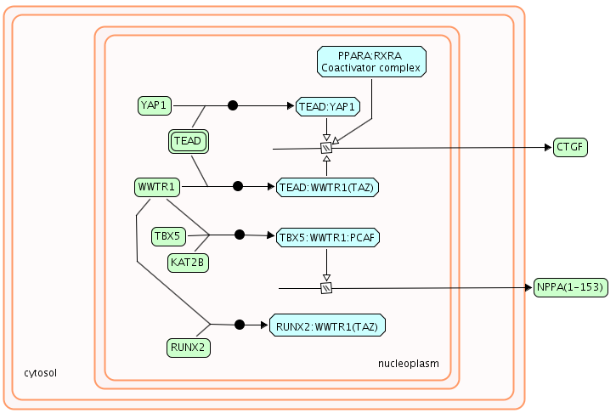
Probabilistic Graphical Models (PGMs) for Reactome Pathways
Notes:
In this example, we have a simple gene expression regulatory pathway where CTGF and NPPA are two generic TFs, which regulate cell proliferation.
The expressions of these two proteins are controlled by upstream proteins, including YAP1, WWTR1, and RUNX2.
By converting a Reactome pathway like this to a PGM, we can try to answers like:
If YAP1 copy number is higher -> Is CTGF exp up?
Or NPPA1 activity high, how likely is WWTR1 exp up or RUNX2 exp down?

Slide 42
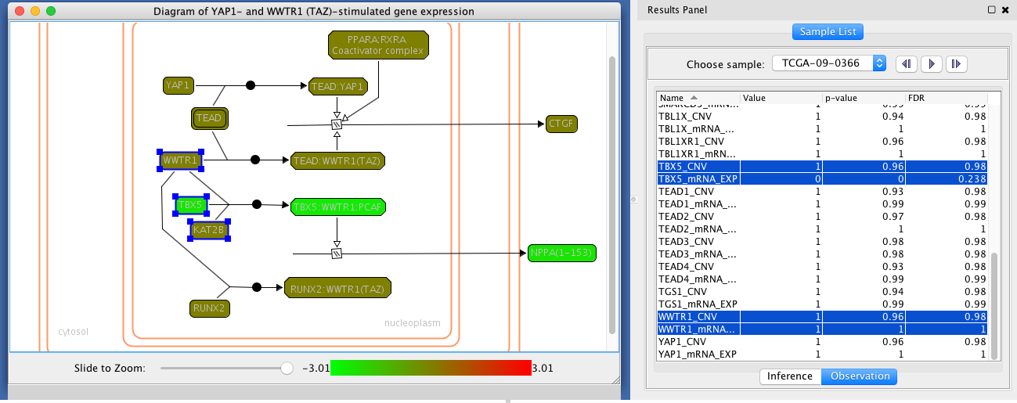
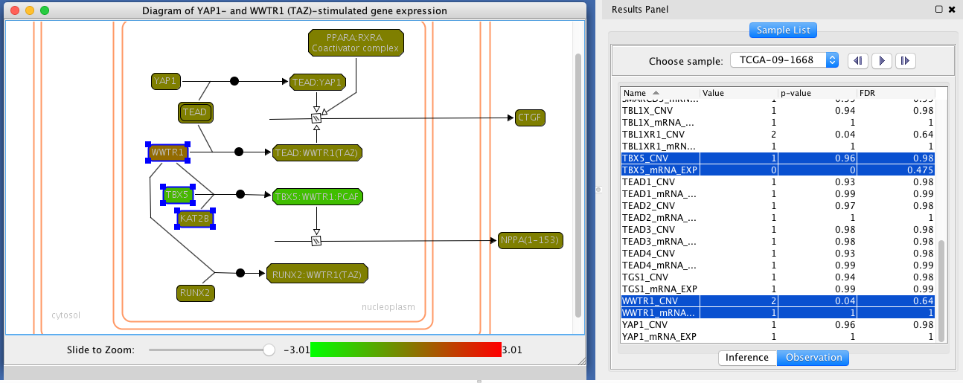
PGM-based Single Patient Pathway View
1
2
Notes:
In this example, CNVs and mRNA expression data from OvCa samples were integrated into the converted factor graph according to the PARADIGM approach.
After that, inference was performed and results with and without CNV and gene expression were compared to see how much pathway entities were impacted by abnormal gene expressions and CNVs, and colored proportionally.
The left panel allows users to view the causes of impact on pathway entities and the right tables display the observed CNVs and mRNA expression values.
This slide shows the comparison between 2 OvCa samples. The first sample has lower expression of NPPA1 than the second sample, most likely because the second sample has a higher CNV value for WWTR1 (2 vs.1).

Slide 43
PARADIGM: Good & Bad News
Bad News
Distributed in source code form & hard to compile.
No pre-formatted pathway models available.
Scant documentation.
Takes a long time to run.
Good News
Reactome Cytoscape app supports PARADIGM (beta testing).
Includes Reactome-based pathway models.
We have improved performance; working on further improvements.

Slide 44
Pathway/Network Database URLs
BioGRID
http:// www.thebiogrid.org
IntAct
http://www.ebi.ac.uk/intact/
KEGG
http:// www.genome.jp/kegg
MINT
http://mint.bio.uniroma2.it
Reactome
http:// www.reactome.org
Pathway Commons
http://www.pathwaycommons.org
Wiki Pathways
http://wikipathways.org

Slide 45
De novo network construction & clustering
GeneMANIA
http://www.genemania.org
HotNet
http://compbio.cs.brown.edu/projects/hotnet/
HyperModules
http://apps.cytoscape.org/apps/hypermodules
Reactome Cytoscape FI App
http://apps.cytoscape.org/apps/reactomefis

Slide 46
Pathway Modeling
CellNetAnalyzer
http://www.ebi.ac.uk/research/saez-rodriguez/software
NetPhorest/NetworKIN
http://netphorest.info, http://networkin.info
ARACNe
http://wiki.c2b2.columbia.edu/califanolab/index.php/Software/ARACNE
PARADIGM
http://paradigm.five3genomics.com/

Slide 47
We are on a Coffee Break & Networking Session

